Slide 1
GreenyDroid
Heramia, Johanna Marisse C. Tadeo, Jose Lorenzo G.

Slide 2
Game application that has stories, questions, facts and mini games.
Different version of Android (e.g Cupcake, Donut, Éclair etc.)
What is GreenyDroid?

Slide 3
To give entertainment.
For the user to be able to know some simple facts or health facts and trivia base on the different name of version of Android.
Objective

Slide 4
People ages from 7 to 15 years old
Target Audience

Slide 5
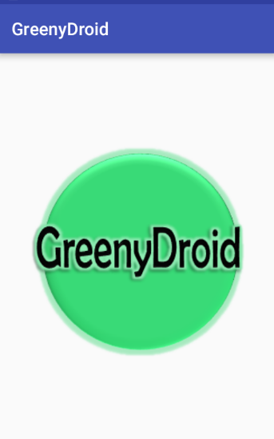
Welcome Page
Features

Slide 6
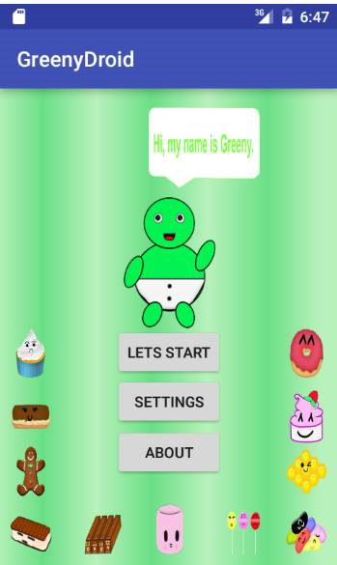
Sub menus
Features

Slide 7
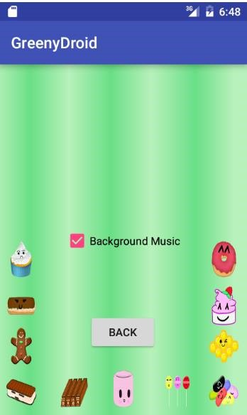
Game setting
Features

Slide 8
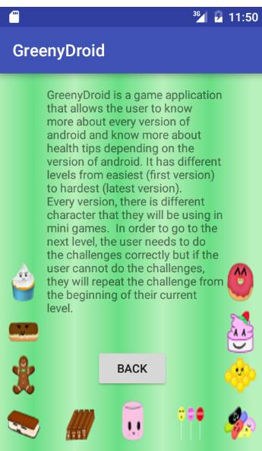
Game About
Features

